Slide 1
AIR QUALITY PREDICTION USING ARIMA MODEL (Mentor: Prof. (Dr.) Debabrata Datta) (Professor of Dept. of IT & Joint Director Research & Development and former BARC Scientist)
Group Members
1.Nikki Priya – 1954082
2. Saket Sagar – 1954077
3. Sundaram Kumar - 1954032

Slide 2
Business Case and Values
Most major cities suffer from high concentration of Air Pollutants.
Predicting future Air Quality helps the Government and Businesses to plan for the mitigation.
Regulating Air Pollution is crucial as air pollutants produces injurious and destructive effects on both human and surrounding environments.

Slide 3
Goal
The aim is to Forecast the Air Quality Index(AQI).
AQI tells you how clean or polluted the air is, and what associated effects might be a concern for one.
The meteorological and traffic factors, burning of fossil fuels, industrial parameters such as power plant emissions play significant roles in air pollution.

Slide 4
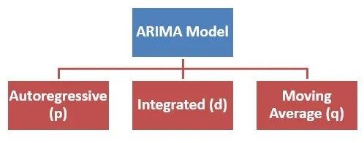
Methodology and Models
ARIMA (Autoregressive Integrated Moving Average) :
a popular time series forecasting model used to analyze and predict future values based on past observations
combines three components: Autoregressive (AR), Integrated (I), and Moving Average (MA).
The AR component represents the dependence on past values in the series.

Slide 5
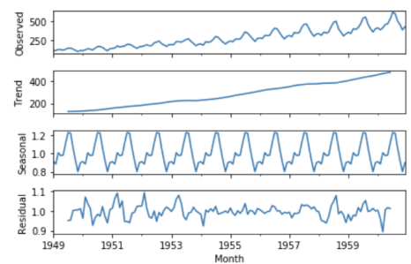
The I component accounts for the differencing needed to make the time series stationary.
The MA component represents the dependency on past forecast errors.
models require the data to be stationary, meaning the mean and variance should remain constant over time.
Figure – Non Stationary(Trends and Seasonality)

Slide 6
Flowchart
ARIMA -
Start
Data
Collection
Data Cleaning
Data Pre-Processing
End
Visualization
Visualization of Predicted
Training Dataset Formation
ARIMA
Model
Model Building
Prediction On test Dataset

Slide 7
1.Data Collection
Initially we have used Air Quality dataset, which contains data about the Air pollutants like CO, O₃,NO₂ , Particulate matter(PM2.5 / PM 10) etc…
Dataset link - https://www.kaggle.com/rohanrao/air-quality-data-in-india

Slide 8
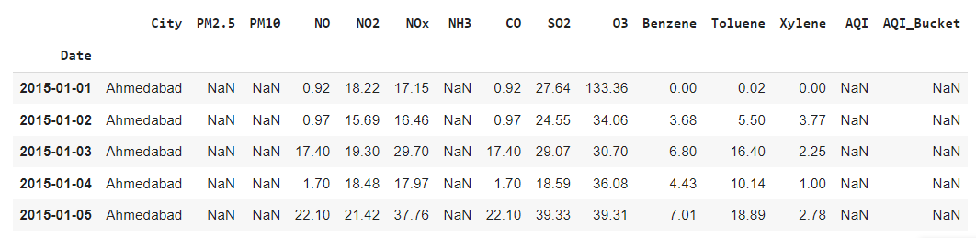
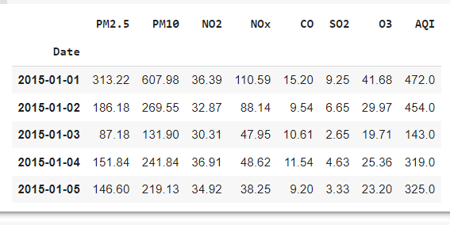
2. Data Cleaning
Data before Cleaning
Data after Cleaning

Slide 9
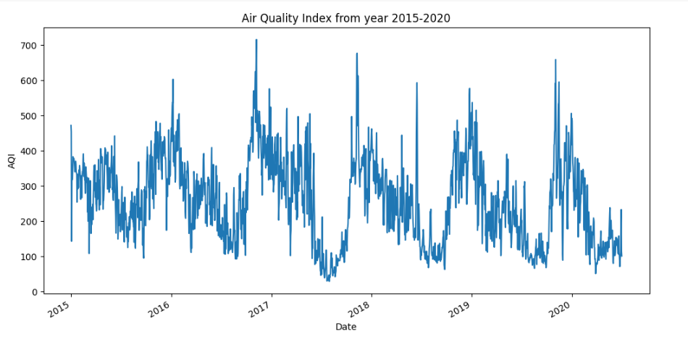
3. Data Visualization
Figure – Air Quality Index from year 2015-2020

Slide 10
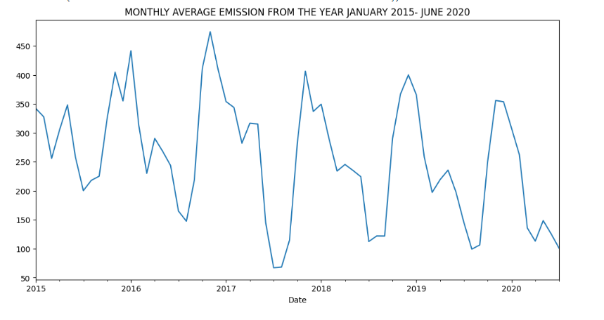
Data Visualization
Figure – Monthly Average Air Quality Index from year 2015-2020

Slide 11
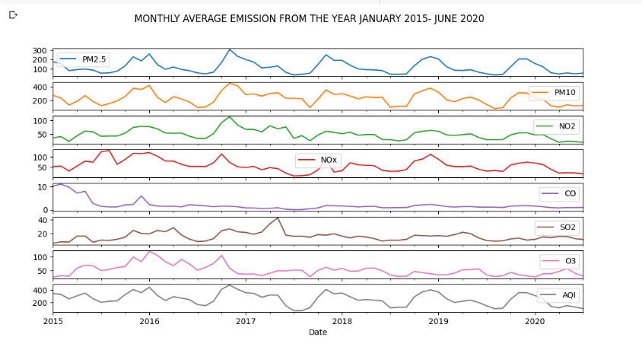
Data Visualization
Figure – Monthly Average Emission from year 2015-2020

Slide 12
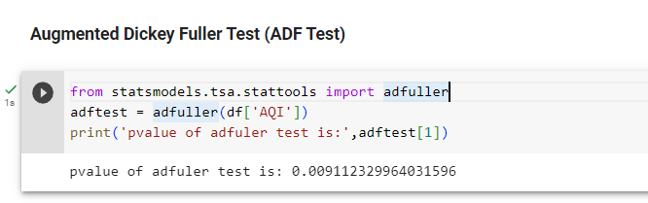
Augmented Dickey Fuller Test
It is a statistical test used to determine whether a time series is stationary or non-stationary.

Slide 13
4. Training and Test Dataset
Original Dataset
(2015-01-01 to 2020-07-01)
(1999 entries)
~ 85 %
~15%
Training
Testing

Slide 14
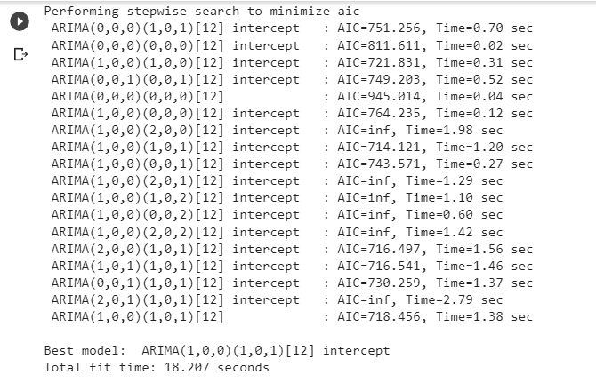
5. Model Building
Finding (p , q and d values) using auto ARIMA

Slide 15
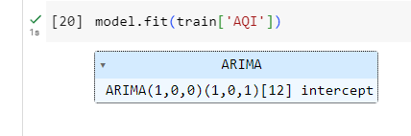
Fitting the Model

Slide 16
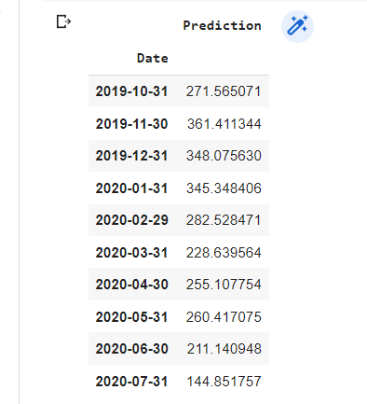
Predictions on Test Data

Slide 17
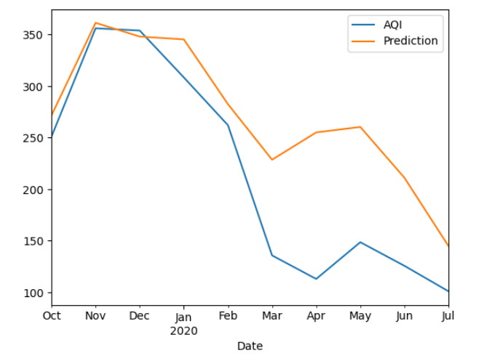
Predictions

Slide 18
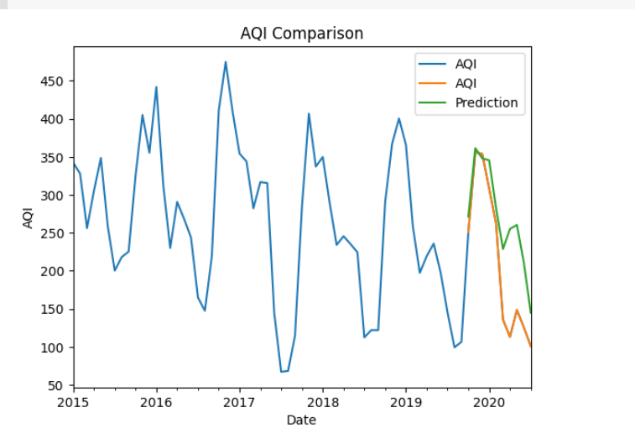
Predictions

Slide 19
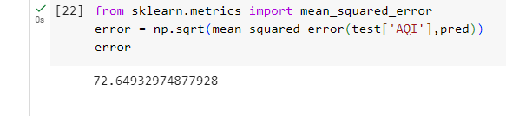
Root Mean Squared Error
It is a measure of the overall "fit" or "error" of the model's predictions, indicating how close the predicted values are to the actual values.

Slide 20
Hurst Exponent (H)
is a measure used to quantify the long-term memory or persistence in a time series
denoted as "H," is a dimensionless value that ranges between 0 and 1.
H = 0.5 suggests a random or uncorrelated series, where future values are independent of past values (similar to a random walk)

Slide 21
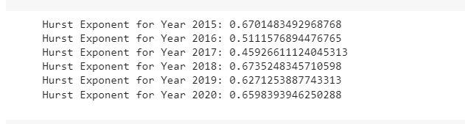
Hurst Exponent
H > 0.5 indicates positive autocorrelation or persistence in the time series, meaning that past values influence future values.
H < 0.5 indicates negative autocorrelation or anti-persistence, where past values tend to have an inverse effect on future values.

Slide 22
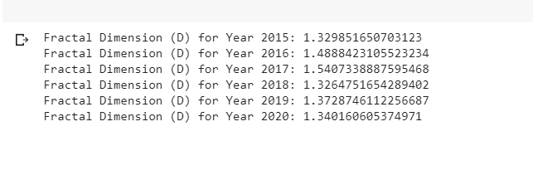
Fractal Dimension
Fractal dimension is a mathematical concept used to describe the irregular and self-repeating patterns found in fractals

Slide 23
Influence of Weather Factors on ARIMA Model
affected by weather conditions, such as temperature, humidity, wind speed, and atmospheric pressure
The ARIMA model assumes that the underlying time series is stationary and exhibits a linear relationship between past and future values
While it can capture trends, seasonality, and autocorrelation, it may not adequately capture the complex and non-linear relationship between weather factors and AQI variations

Slide 24
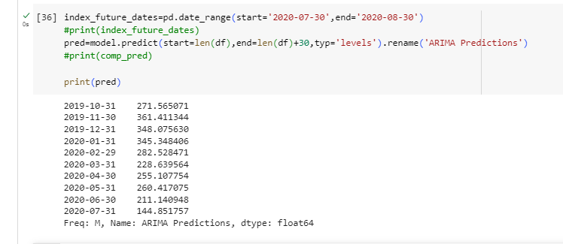
Future Predictions

Slide 25
Conclusions
Air quality prediction is a crucial area of research and application due to the significant impact of air pollution on human health and the environment.
Through this project, we aimed to develop an accurate and reliable model for predicting air quality levels, leveraging machine learning techniques
We successfully implemented and trained a machine learning model, such as a hybrid approach combining regression and time series techniques, to forecast air quality levels

Slide 26
Conclusions
The findings from this project can be utilized by environmental agencies, policymakers, and individuals to make informed decisions, take preventive measures, and mitigate the adverse effects of air pollution.
It is essential to continue monitoring and improving air quality prediction models to address the dynamic nature of air pollution, adapt to changing conditions, and ensure effective decision-making and policy implementation.

Slide 27


